Slide 1
Student Learning Management System

Slide 2
Project overview
The Student Learning Management System (LMS) is a platform designed to enhance the educational experience for students, instructors, admins, and support teams. It features user management, course creation, assignment submissions, grading, and customer support through a ticketing system. Developed in five phases—Planning & System Design, Frontend Development, Database Operations, Backend Development, and Testing & Deployment—the system will be secure, scalable, and user-friendly. The project aims to streamline educational processes and ensure a seamless user experience for all roles involved

Slide 3
System Requirements & Features
User Roles:
Students: Access course materials, submit assignments, and view grades.
Instructors: Upload materials, grade assignments, and track student progress.
Administrators: Manage users and oversee platform maintenance.
Core Features:
User Registration & Authentication
Course Management
Assignment Submissions & Grading
Discussion Forums
Notifications/Reminders
Reporting & Analytics
System Requirements:
Hardware: Servers, storage solutions for data.
Software: Web framework, database, authentication system.
Performance: Fast response times, scalable for increasing users.

Slide 4
Goals of the LMS
Accessibility: Ensure the platform is accessible on various devices (desktop, tablet, mobile).
Usability: Intuitive interface for students, teachers, and administrators.
Security: Implement secure login, data encryption, and user privacy protocols.
Scalability: Ability to handle a growing number of users and courses.
Integration: Compatibility with third-party tools like Zoom, Google Docs, etc.

Slide 5
Technology Stack & Tools
Frontend Technologies:
Streamlit (Python Package) for a responsive, user-friendly interface.
Backend Technologies:
MongoDB for database management.
Tools & Frameworks:
Git for version control.
Deployment & Hosting:
Streamlit Cloud for cloud hosting.

Slide 6
Core Requirements
User Management:
Role-based access: Admin, Instructor, Student, Customer Support.
Secure registration, login, and profile management.
Course & Assignment Management:
Instructors create, manage, and organize courses.
Students can enroll, submit assignments, and track progress.
Grading system with feedback, gradebook for tracking.
Communication Tools:
Discussion forums and messaging systems for interaction.
Notifications for deadlines, grades, and updates.
Data Storage & Management:
No database (e.g., MongoDB) for storing user data, courses, Files, and grades.
Scalable data management to accommodate growth.

Slide 7
Security & Privacy:
Data encryption (passwords, grades, personal info).
Role-based access control and privacy protections.
Regular backups and disaster recovery plan.
Reporting & Analytics:
Student performance tracking and course progress reports.
Admin system usage reports for scaling and improvements.
Scalability & Performance:
Optimized for high traffic and multiple users.
Fast response times for course access, submissions, and grades.
Third-Party Integrations:
Support for external tools like Google Classroom, Zoom, and Dropbox.
APIs for data sharing with other educational platforms.

Slide 8
System Overview: The project is focused on building the core functionalities of a Student Learning Management System (LMS). The goal is to ensure a fully functional platform that serves the needs of students, instructors, administrators, and customer support roles.
Key Features:
User Registration and Authentication: Ensures that users (students, instructors, administrators) can securely register and log in using credentials.
Course Management System: Instructors can upload materials, create assignments, and track student progress without worrying about how the visual layout is rendered.
Assignments and Grading: Allows students to submit assignments and instructors to grade them, focusing on the functionality of submission and grading rather than the appearance.
Admin Management Tools: Admins can manage users, such as creating accounts or updating roles, without considering how the interface is designed.
Database Operations: Handling data such as course information, student grades, and user roles in the background without detailing how it’s presented in the UI.

Slide 9
Implementation Details
Languages Used:
Python
Platform/Software:
Frontend: Streamlit (Python Package).
Database: MongoDB.

Slide 10
Testing – Unit & Functional Testing
Unit Testing:
Each team member was responsible for writing unit tests for their respective components.
Tools used: PyTest.
Functional Testing:
End-to-end testing was conducted to ensure all features worked as intended.
Test cases included user registration, course management, and grade submissions.
Testing Experience:
Found several edge cases that required code adjustments.
Improved the authentication flow and database query performance.

Slide 11
Feedback from Peer Reviews
Feedback Received
Reflections
Action Taken

Slide 12
Code Inspection Results & Resolution
Code Inspection Results:
Found a few areas where the code could be optimized for better performance.
Some database queries were inefficient, and error handling was inconsistent.
Resolution:
Refactored database queries for speed and reliability.
Standardized error handling across the platform.

Slide 13
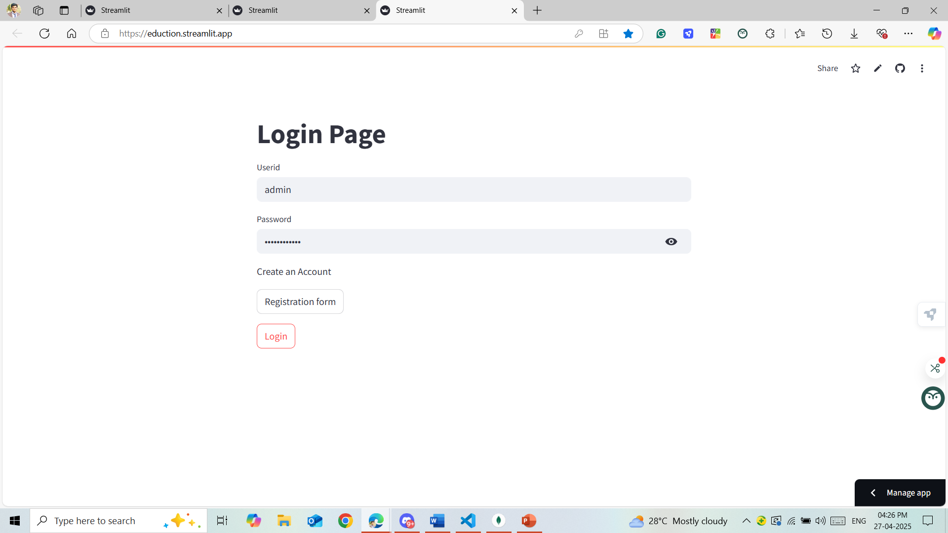
Login Page
Purpose: The Login Page acts as the secure entry point for users (students, teachers, and admins) to access the Student Learning Management System.
Key Features:
Username and Password Fields
Secure Authentication

Slide 14
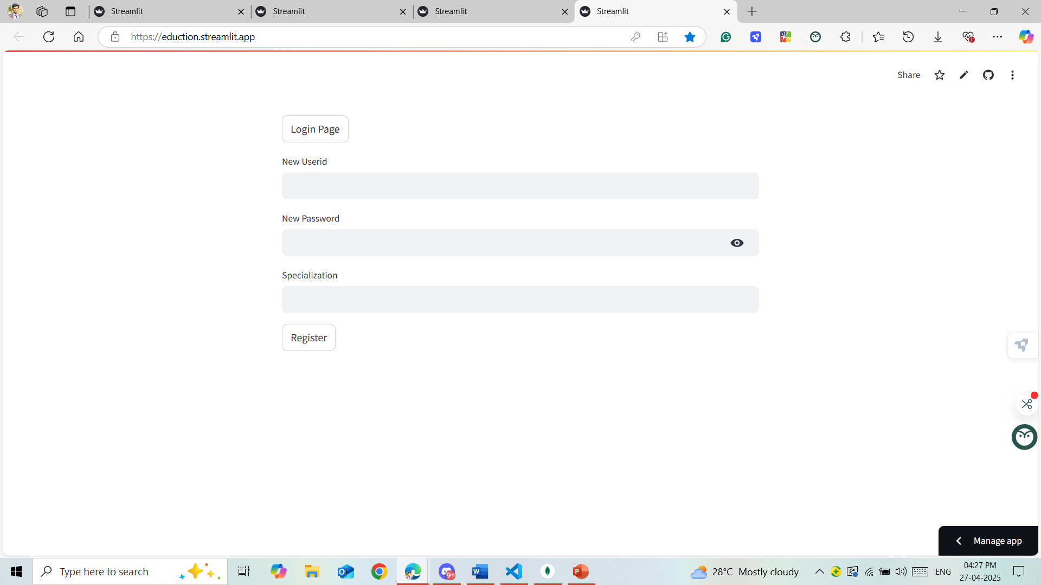
Registration Form for Student Users
The Registration Form is designed to securely collect essential information from new student users to create their personal accounts in the Learning Management System. This allows students to access courses, materials, grades, and communication tools within the platform.

Slide 15
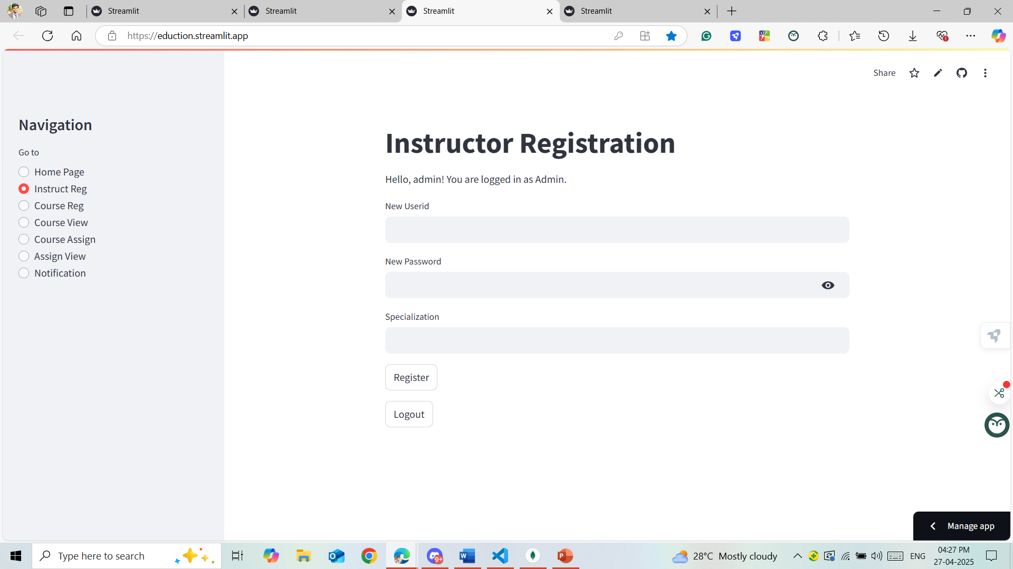
Instructor Registration Form
The Instructor Registration Form allows qualified individuals to register as instructors within the LMS platform, providing them the ability to create courses, manage student enrollments, and facilitate online learning activities.

Slide 16
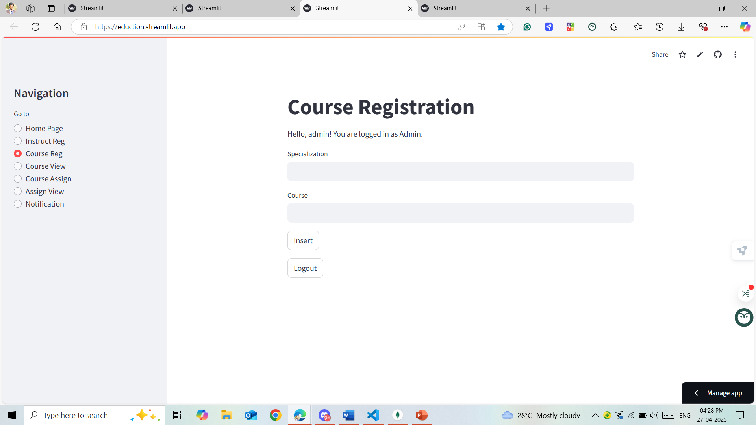
Course Registration Form
The Course Registration Form is a key feature of the Student Learning Management System (LMS) that allows students to enroll in courses offered by their institution. It streamlines the process, ensuring students can easily find, select, and register for courses based on their academic plan.

Slide 17
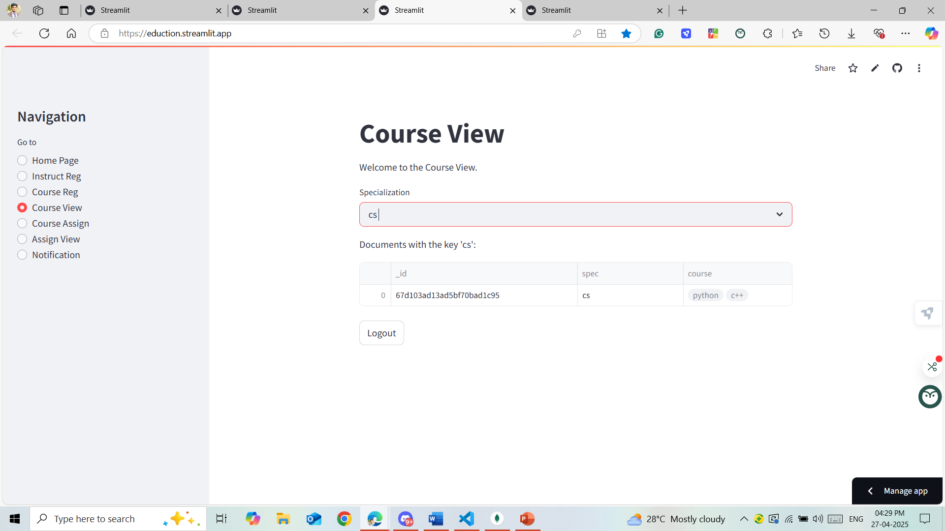
Course View by Admin
the Admin manages and monitors Course Views accessible to Student Users. This feature ensures students see up-to-date, organized course information for effective learning.

Slide 18
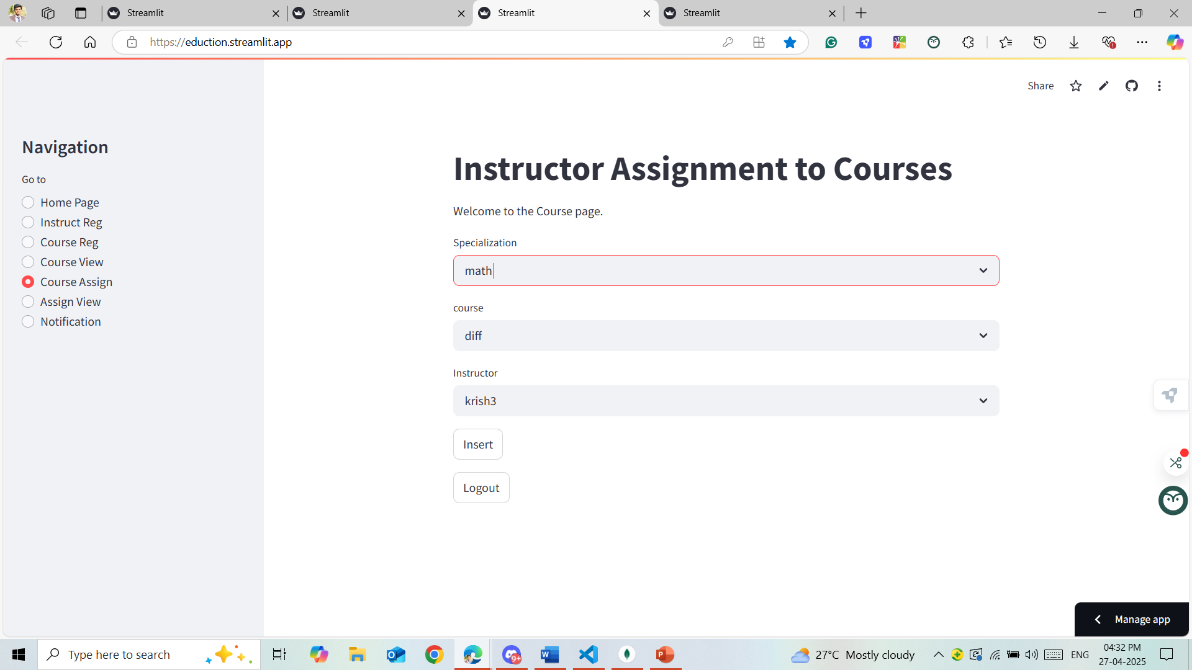
Instructor Assignment to Courses
Assigning instructors to courses is a critical administrative function that ensures the right educators are linked to the right classes. This process helps organize course management, content delivery, student interaction, and performance tracking effectively.

Slide 19
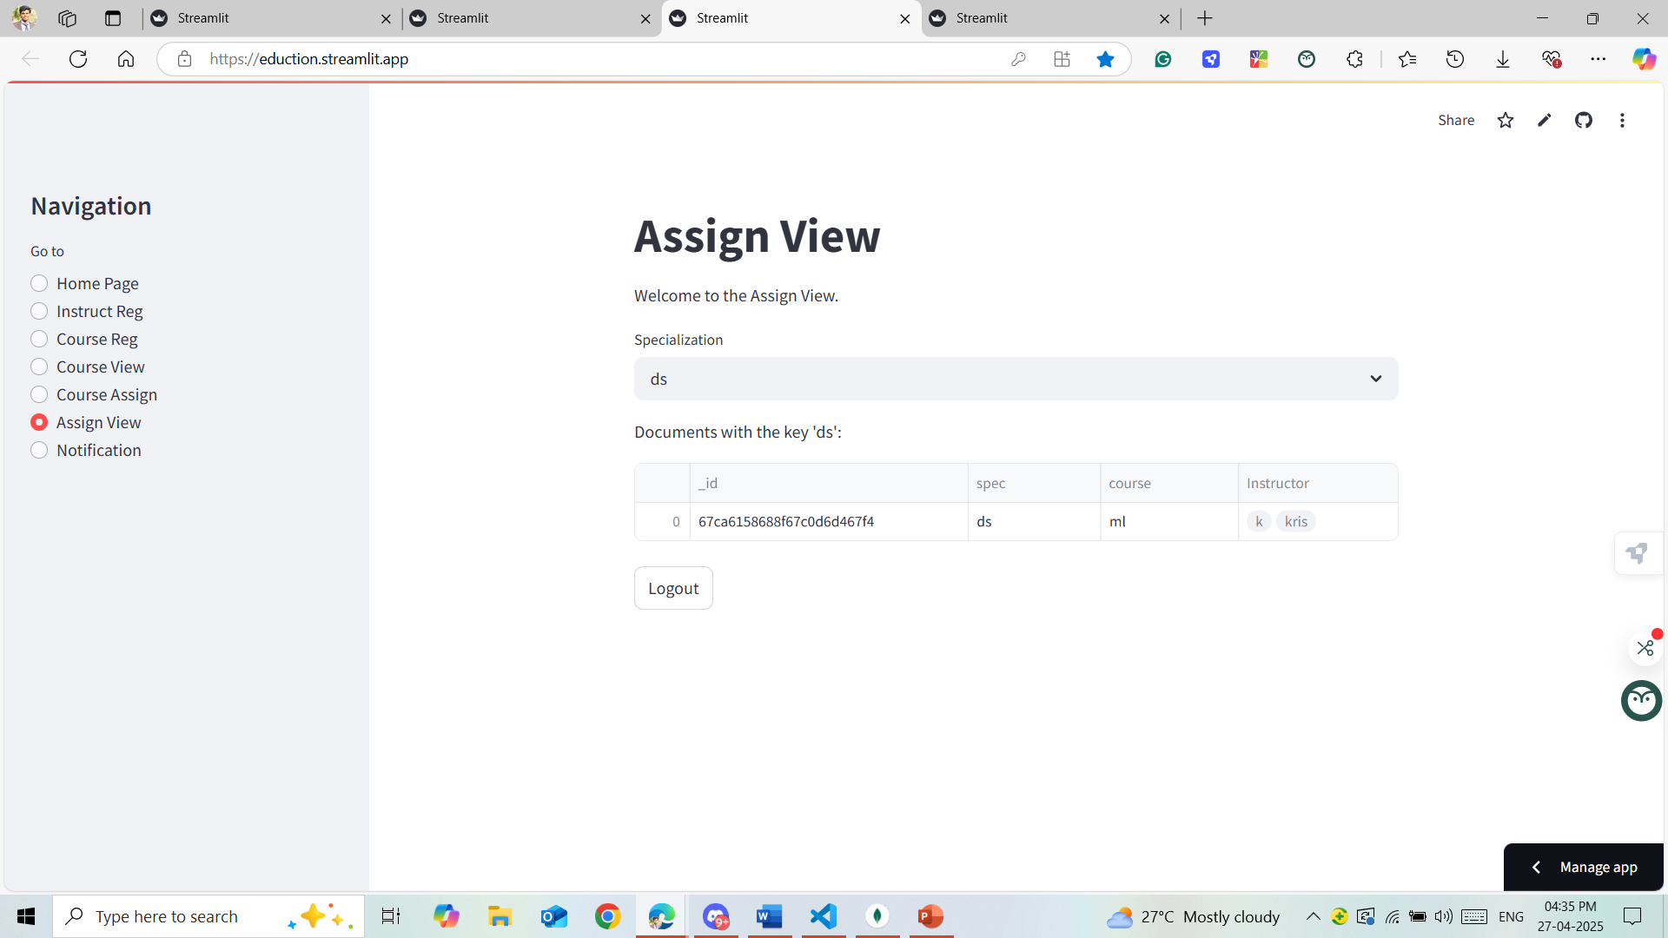
Instructor to Course View
allows instructors to manage, organize, and monitor their courses effectively. This view is tailored to instructors, giving them full control over course content, student engagement, and performance tracking.

Slide 20
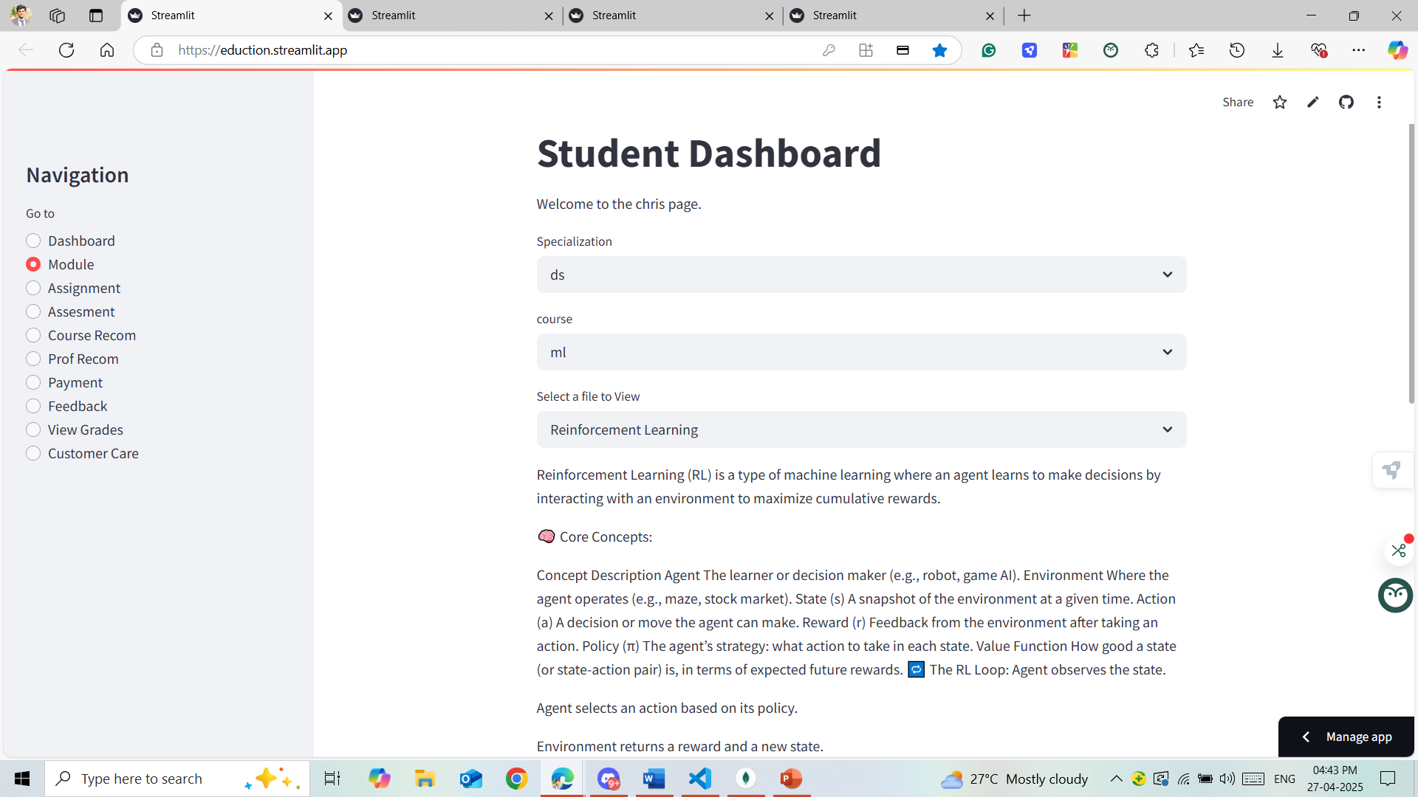
Learning Content for a Course uploaded by the Instructor student view
Upon logging into the LMS and selecting their course, students navigate to the Learning Content or Course Materials area. Here, the PPT files are organized by topic, week, or module for easy access. Each uploaded presentation includes a title, a brief description (if provided by the instructor), and the date it was uploaded.

Slide 21
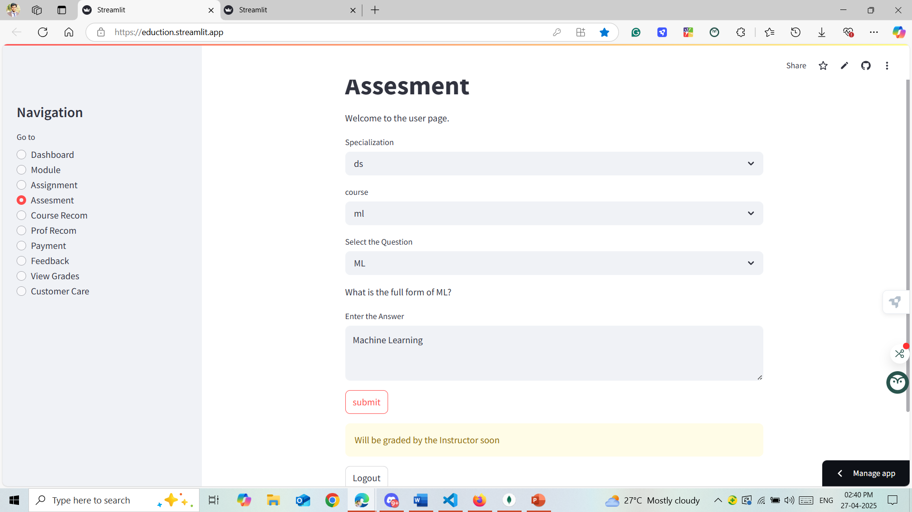
Assessment View of Student:
The Assessment View page allows students to:
View their past, ongoing, and upcoming assessments.
Check their grades and feedback for individual assignments or exams.
Track their progress over the course of a semester.

Slide 22
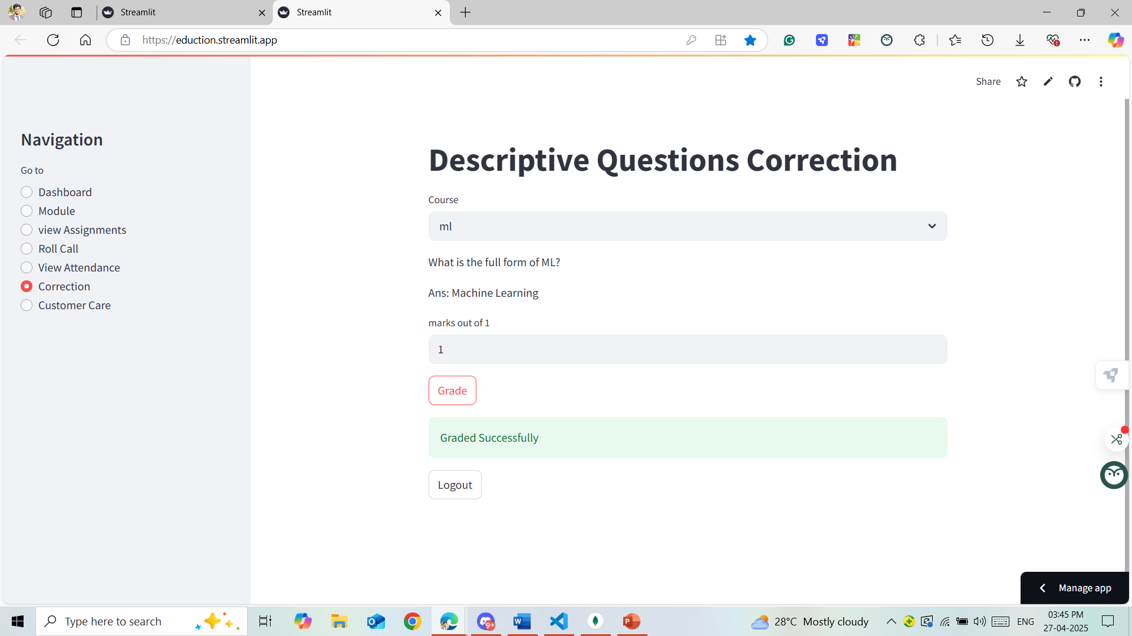
Descriptive Question Manual Grading:
Manual grading involves instructors reviewing and scoring descriptive or open-ended answers provided by students in response to exam questions or assignments.
Unlike automated grading, this method requires human assessment of the quality, accuracy, and completeness of the responses.

Slide 23
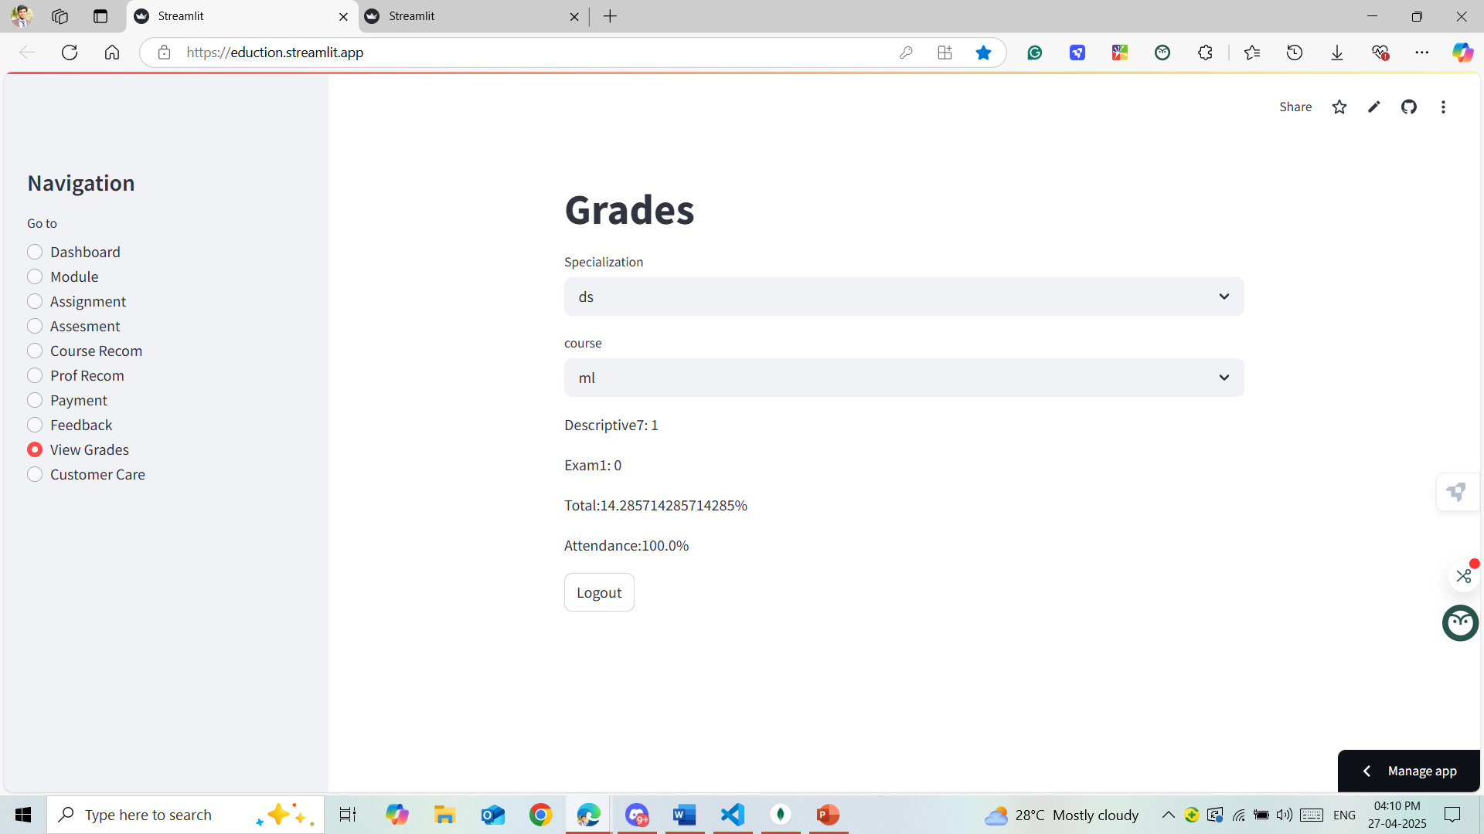
Grades:
The Grades page allows students to view their academic performance across various courses.
Provides an interactive platform for tracking grades, assignments, quizzes, and overall progress.

Slide 24
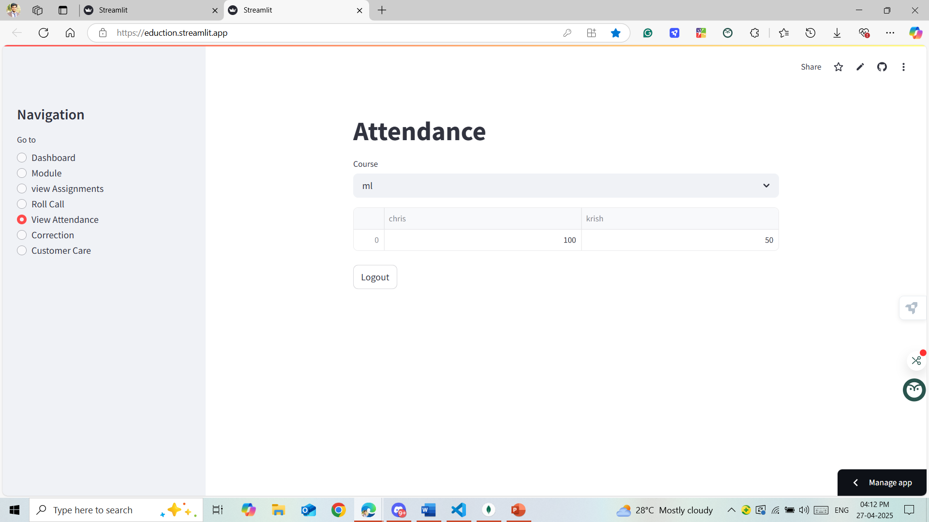
Instructor Attendance View:
The Instructor Attendance View is designed to help instructors efficiently monitor student attendance in their courses. This page provides a user-friendly interface for tracking and managing attendance records, ensuring instructors can stay organized and ensure timely reporting.

Slide 25
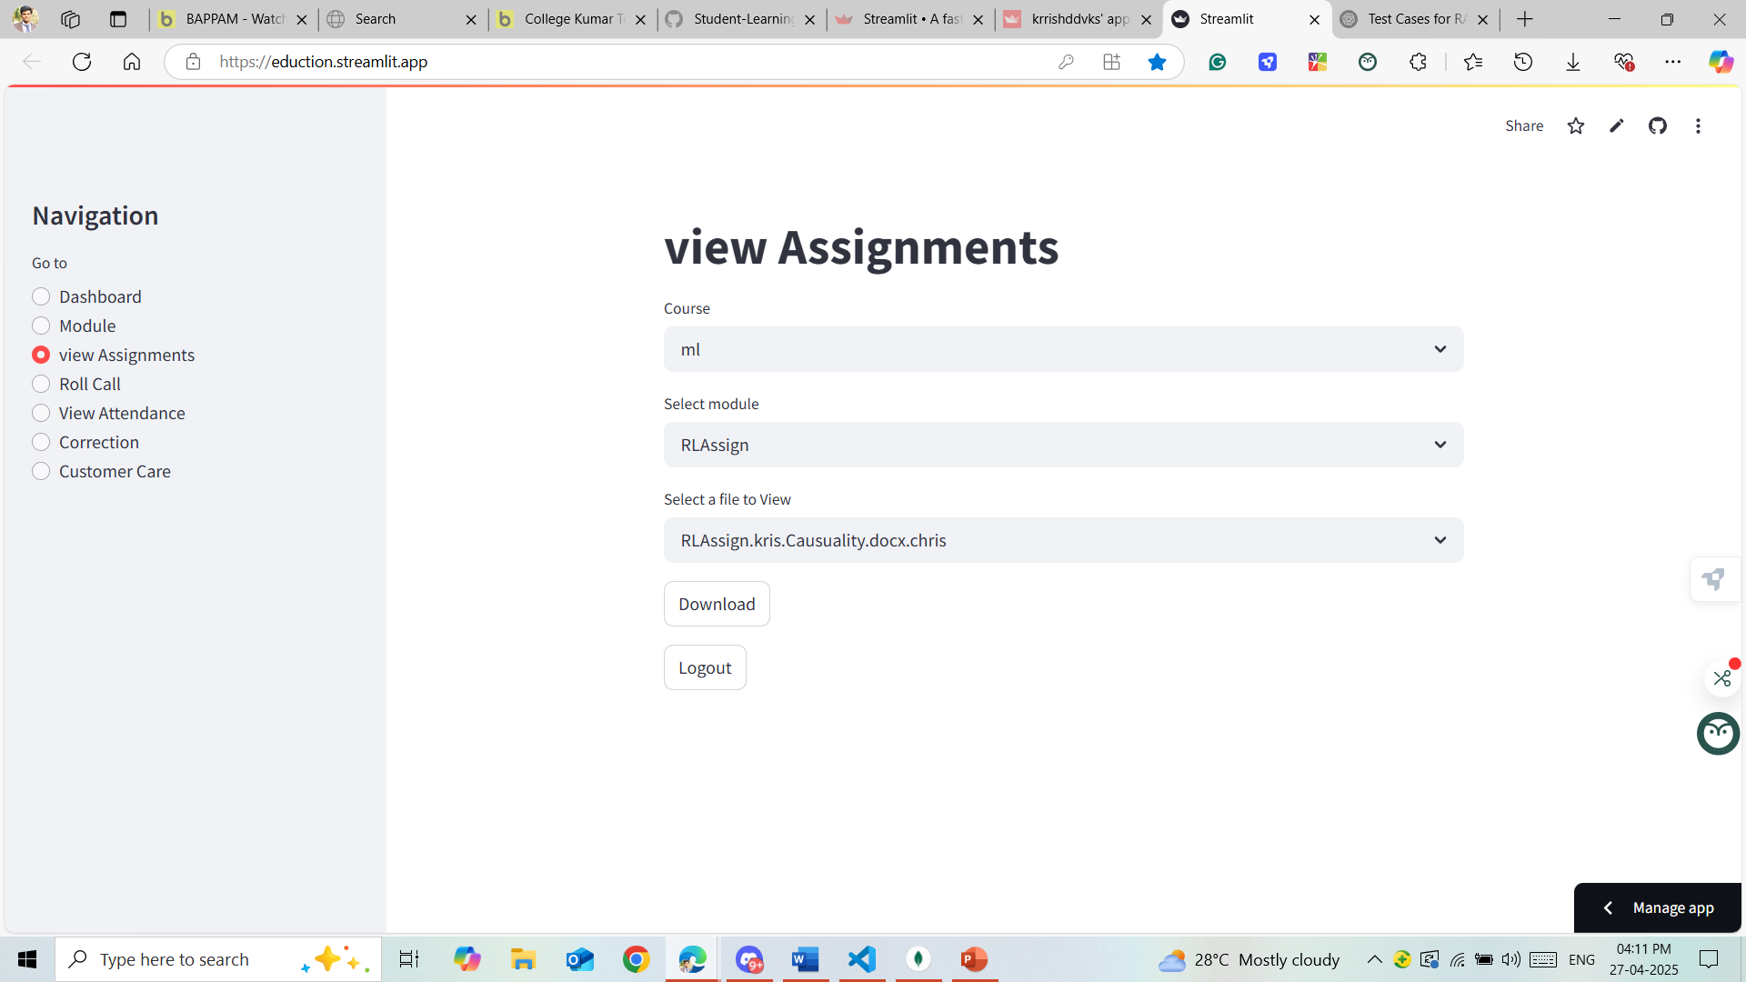
View Assignments by Instructor
The "View Assignments by Instructor" page allows students to access a list of assignments set by their instructors, complete with details such as deadlines, instructions, and submission status.

Slide 26
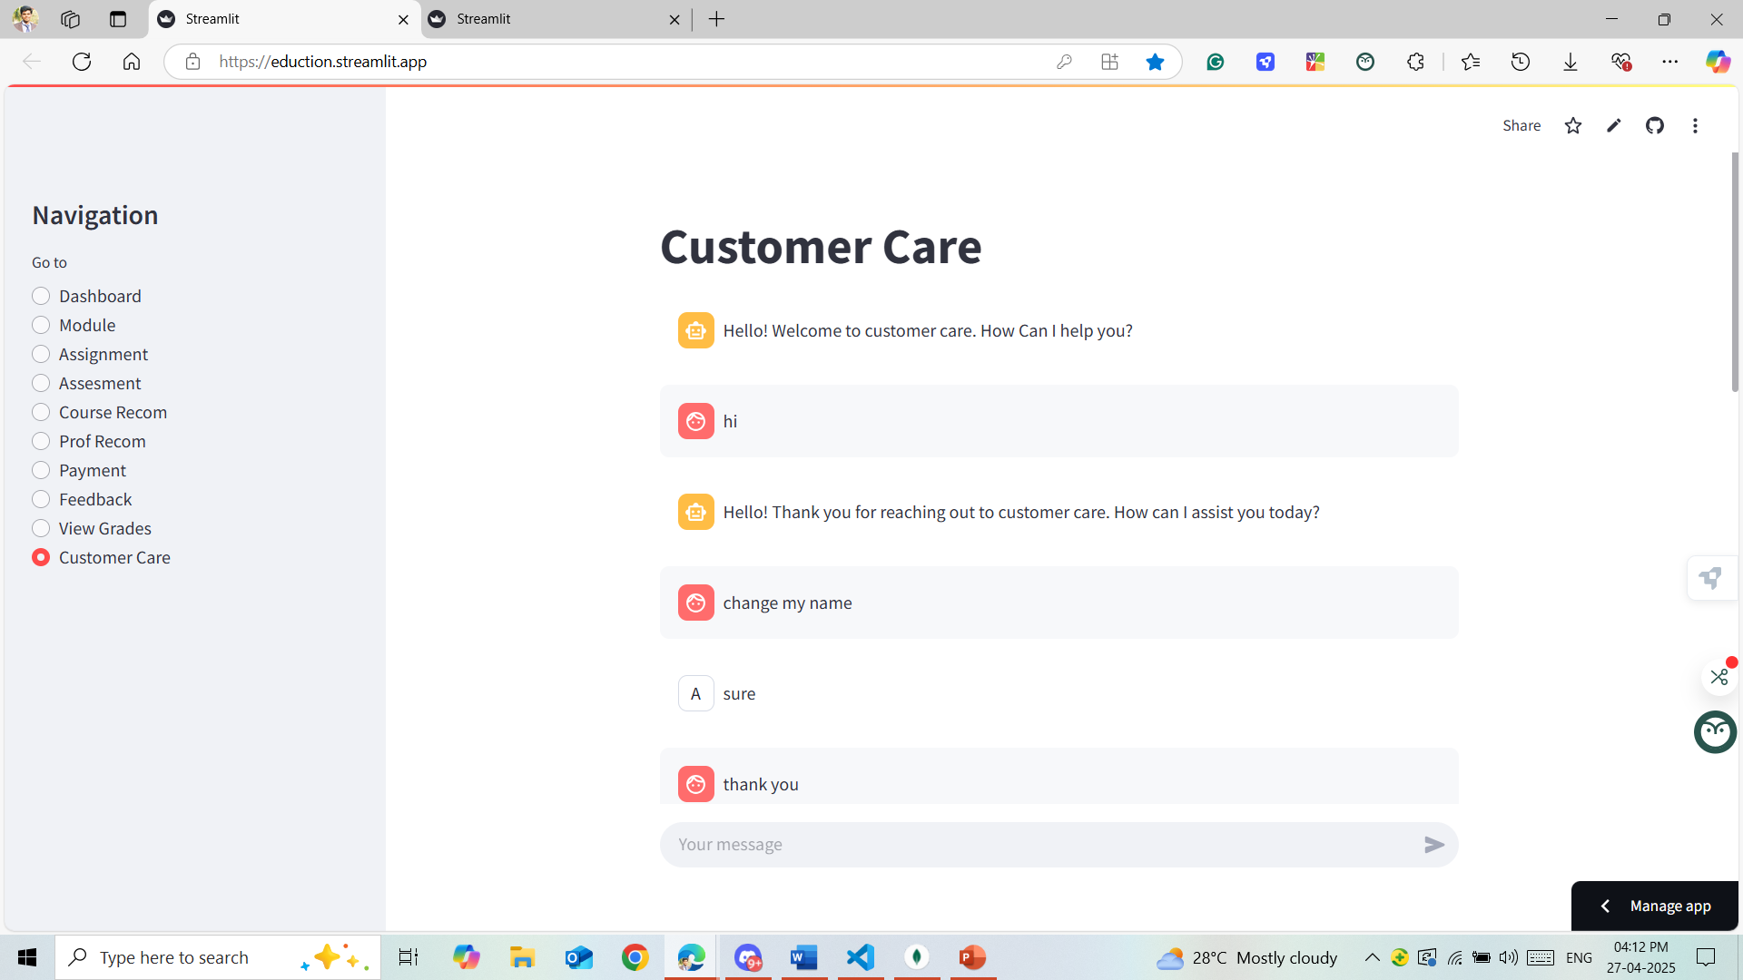
Customer Care
The Customer Care page is designed to assist students, faculty, and staff with any questions or issues related to the LMS. It provides various resources to ensure smooth usage of the system

Slide 27
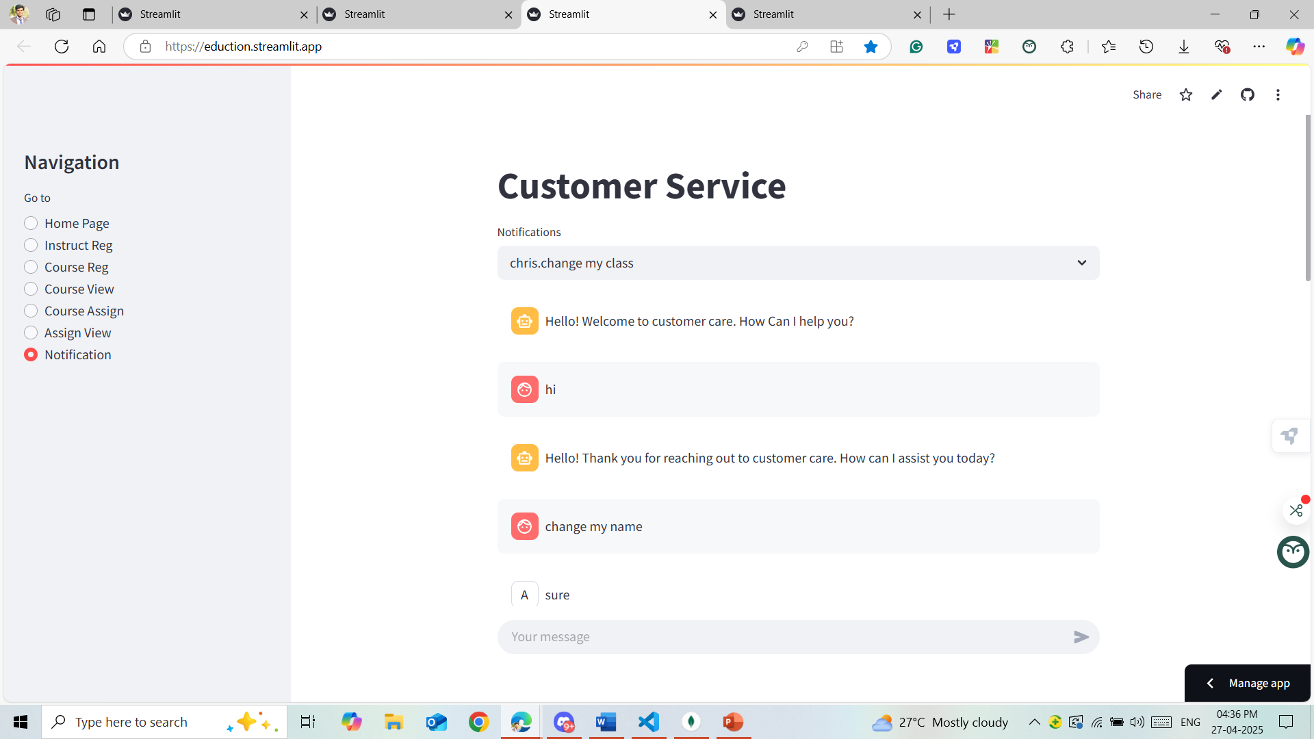
Notifications to Admin
The Notifications to Admin page serves as a central hub for all critical alerts and updates that require administrator attention in the Student Learning Management System. It ensures that administrators can effectively manage and address important events, activities, and system statuses in real-time.

Slide 28
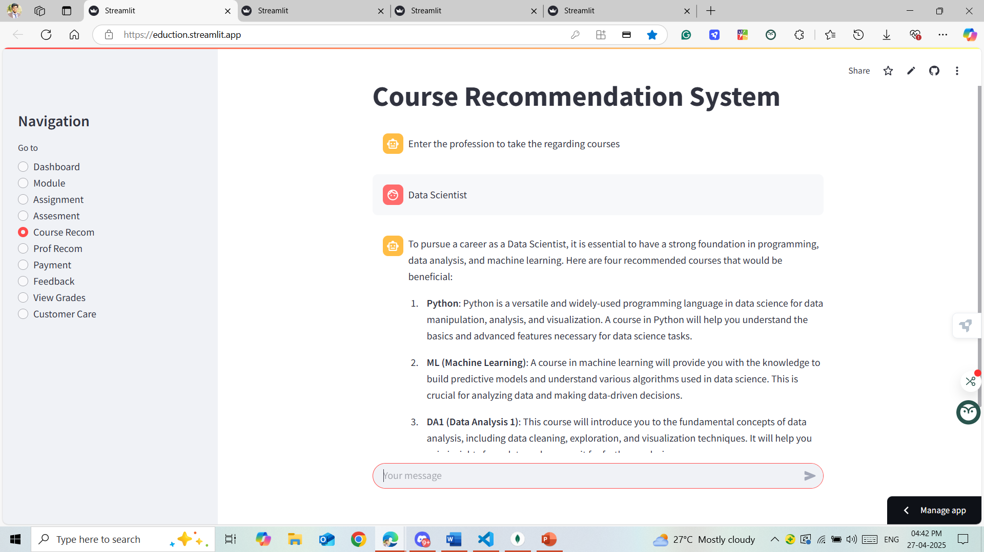
Course Recommender
The Course Recommender is a feature in the LMS designed to help students select courses based on their academic interests, past performance, and future goals.
Using algorithms, the system recommends relevant courses tailored to each student's learning journey.

Slide 29
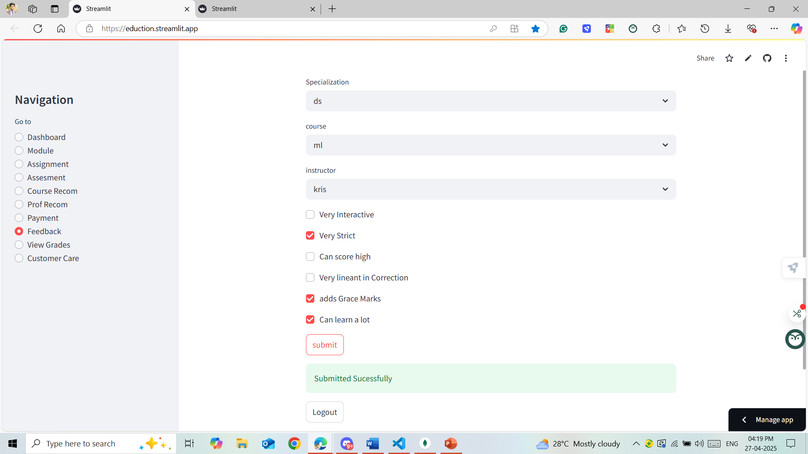
Feedback For Instructor
Provide a space for students to share their thoughts on the course and instructor's teaching methods.
Help instructors improve their teaching and provide students a voice in the learning process.

Slide 30
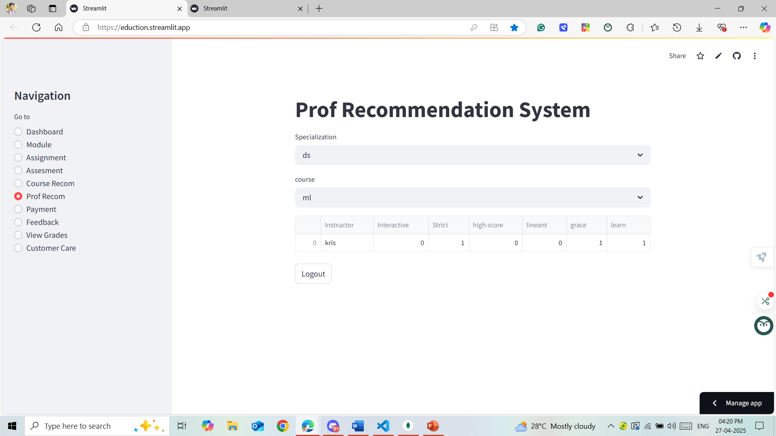
Professor Recommender
The Professor Recommender page is designed to assist students in identifying and connecting with professors who align with their academic interests and learning styles. The system provides personalized recommendations based on student profiles, course interests, and academic performance.

Slide 31
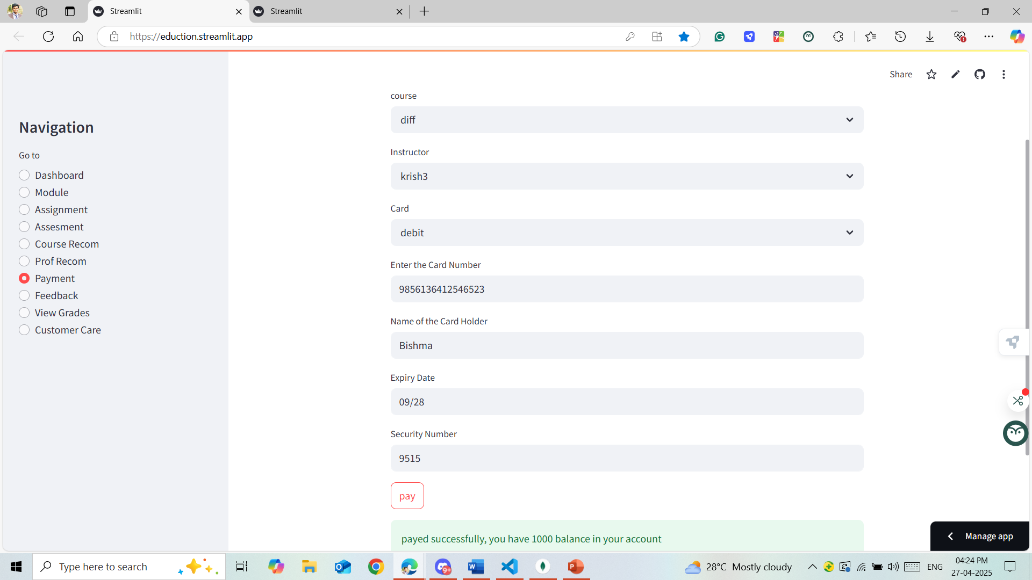
Course Payment
The Course Payment page allows students to securely complete transactions for course enrollment. It integrates with the LMS system to ensure seamless access to courses upon successful payment.

Slide 32
Project Achievements: The Student Learning Management System (LMS) successfully meets educational needs by enabling efficient course management, seamless user interaction, and secure data handling. Key features include user registration, course management, assignment submission, grading, and communication tools.
Future Plans: Ongoing improvements will focus on scalability, system performance, and integration with additional third-party tools to enhance the user experience and expand functionality.
Impact: The LMS provides a solid foundation for modern educational environments, ensuring a user-friendly, secure, and scalable platform that meets the needs of students, instructors, and administrators alike.

